Slide 1


Slide 2

GUIDELINES FOR
LEADERSHIP SITE
ENGAGEMENT
COS-03-01
COS WEBINAR
May 26, 2021
SECOND EDITION | NOVEMBER 2020
Notes:
Russ: Good Morning and welcome to the COS Webinar: Guidelines for Leadership Site Engagement. Ideally, this guide will assist leaders at all levels in communicating more effectively with operational staff. On behalf of today's speakers, thank you for joining us to hear about one of our updated guidance documents and why we published these guidelines to support the industry. I’m Russell Holmes, Director of the Center for Offshore Safety. Since we are recording today’s webinar, which will be available on our website, we have muted all attendees to cut down on the possibility of background noise. Throughout this presentation, if you have questions for our speakers, please type them in the chat box. We’ll gather those questions and present them to our speakers at the end of the webinar. You will also be able to engage in a discussion with the speakers during the Question and Answer section.

Slide 3



COS OVERVIEW
The Center for Offshore Safety is designed to promote the highest level of safety for the offshore oil and gas industry through effective leadership, communication, teamwork, use of disciplined management systems and independent third-party auditing and certification.
COS will achieve operational excellence by:
Enhancing and continually improving industry's safety and environmental performance.
Improving public confidence and trust in the oil and gas industry.
Increasing public awareness of industry's safety and environmental performance.
Fostering collaboration between industry, the government, and other stakeholders to develop and share good practices and learnings.
Notes:
Russ: Before we dive into the details, I’d like to provide a little bit of background about the Center for Offshore Safety, which is open to all industry participants. COS was established almost 10 years ago and remains focused on safe operations for the offshore workforce.
[Click now to display 4 pillars] Our collective efforts can be broken down into four main pillars, listed on the right side of this slide, to promote systems that drive offshore safety progress; analyze offshore safety data to identify opportunities for improvement; and facilitate development and sharing of good practices that advance safety and environmental protection. Related to these pillars, COS also serves as the Accreditation Body, recognized by the Bureau of Safety and Environmental Enforcement, to certify third party auditors.

Slide 4




AGENDA
OVERVIEW/SCOPE OF LEADERSHIP SITE ENGAGEMENT (LSE)
OFFICE BASED OPERATIONS LEADERS LSE
SENIOR LEVEL LEADERSHIP LSE
SPECIFIC TOOLS AND EXAMPLES
Notes:
Russ: Today I'll talk about what is a Leadership Site Engagement and then Laurie Knape [slides 10-18] with Avetta will provide an overview about the updated document along with a brief discussion centered around Senior Level Leadership. Jason Anderson with Hess Corporation [slides 19-33] will walk us through LSE for Office Based Operations Leaders and Josh Oldag [slides 34-end] with Oceaneering will outline some of the specific tools and examples that are available in the document.

Slide 5
LEADERSHIP SITE ENGAGEMENTS (LSE)
LISTEN
LEARN
ENGAGE
Notes:
Russ: It's important for senior level leaders and office based operations leaders to make regular visits to offshore worksites to listen, learn and engage with the workforce. These visits allow the leaders to remain informed about what's actually happening offshore as well as an opportunity to gain a greater firsthand appreciation about the hazards, concerns and efforts to address safety at the worksite.
[Click for each block when I read the word in the first sentence - Listen, Learn, Engage]

Slide 6
INTRODUCTION
Second edition incorporates learnings from the past decade
Commitment to support safe operations / safety culture
Resource/tool to assist leaders at all levels to communicate more effectively at work sites with operational staff
Notes:
Russ: Guidelines for Leadership Site Engagement was COS’ first good practice document and was created prior to any of our initial safety data collection efforts. You might be wondering why? COS member companies strongly believed this was the most important good practice to do first and was a necessary foundational document in support of SEMS. It was apparent based on findings from the Deepwater Horizon incident and our other understandings of safety in the industry, that two-way communication was a key element in an effective Safety and Environmental Management System. And in particular, effective communication and engagement between leadership at all levels, including both onshore and offshore operational leadership.
In the intervening decade, we have seen the focus of discussion and focus of various studies and recommendations move from SEMS to include safety culture, human behavior, and full engagement for both offshore and onshore personnel supporting a company’s SEMS. Of course all of these are interrelated and supportive of each other, and all key aspects of an effective and complete risk management system. What we have seen and learned has convinced us that Leadership Site Engagement is more important than ever and this document must remain a key part of the COS portfolio of good practices. Thus, COS and its members decided to update the LSE first edition with what we have learned with this shift to focus not only on improving the effectiveness of SEMS, but to incorporate and highlight the role safety culture plays in supporting safe operations. Additionally, we expanded the document to be applicable to all offshore operations, not just the Deepwater Industry.

Slide 7
WHAT IS LSE?
  Commitment to the workforce and their welfare
  Openness and willingness to be transparent
  Understanding of what they do and the environment they work in
Notes:
Russ: In the fourth edition of American Petroleum Institute, API, Recommended Practice 75, one of the key SEMS principles is Commitment. A key element of Commitment is "An environment where communication is open, clear, and concise to foster understanding, encourage diverse opinions and constructive debate, and promote transparency.” And that this open communication is seen by all as an opportunity to learn and improve. Additionally, relative to Human Performance, RP75 says “Leaders commit to responding in a way that improves human and team performance.” And lastly under the Leadership element it says “Leaders’ actions dictate and demonstrate the direction, expectations, and acceptable behaviors to the workforce and influence all aspects of a Company’s performance.” This highlights that communication and the interaction between leadership at all levels and the workforce is the foundational key to achieving effective implementation of SEMS, a positive Safety Culture, and all-around commitment to safety.
Unfortunately, we often see in safety and incident data that communication is not always accomplishing the results we want. We see it in all types of communication. So it's important to focus your Leadership Site Engagement on communications since it is a key enabler to demonstrate your workforce commitment to safety and a good safety culture.

Slide 8
WHAT IS LSE?
Observations as a Leader
Asking open-ended questions
Questions and your observations also demonstrate:
  level of commitment
  expectations
  level of understanding of the work and safety environment
Notes:
Russ: The other aspect of a Leadership Site Engage is your observations. Your observations can be guided by asking leading and open questions that also support the conversation, rather than questions with a yes/no outcome. Think about the 5 W's: who, what, where, when, why. The questions can be along the lines of:
What are the major hazards here?
What are the barriers you maintain to prevent them from escalating?
Who is responsible for each barrier and its health?
How do you measure barrier health?
Certainly these questions and the discussion will give you an understanding of SEMS at your location as well as the safety culture and the level of commitment to your SEMS expectations. But also the observations demonstrate your level of commitment, as well as what your expectations are, along with your level of understanding of the offshore work and safety environment or culture at that location.

Slide 9
LSE IN SUMMARY
LSE allows you as a leader thru open conversation at the site to:
  Demonstrate visible commitment to safe operations and care for the staff
  Demonstrate visible commitment to a good Safety Culture
  Observe if SEMS is achieving your desired results at the site
  Observe and understand the safety culture at the site
LSE is about Leaders – Listening, Learning, and Engaging
Notes:
Russ: In summary a Leadership Site Engagement allows you as a leader to:
Demonstrate visible commitment to safe operations and care for the staff
Demonstrate visible commitment to a good Safety Culture
Observe if SEMS is achieving the desired results at the site
Observe and understand the safety culture at the site
And while site engagements are designed for Leaders to Listen, Learn and Engage, it is also about workforce engagement in safety and SEMS. While it is possible for personnel to be passive observers in SEMS, safety processes, and risk management, ideally we want the full engagement in safety from every one. Leading by example across various levels of leadership actively encourages and engages participants in safety including observing, intervening, suggesting improvements, and taking individual responsibility to continually improve safety. In conclusion, Leadership Site Engagements are a key component in setting the tone for offshore safety.
Let’s move on to the document itself and the rest of our webinar, keeping in mind that this document is not prescriptive, rather it is a resource for you and a selection of tools and principles that we hope you will use often. Laurie, over to you.

Slide 10
TABLE OF CONTENTS
SCOPE
DEFINITIONS
ACRONYMS
SENIOR LEVEL LEADERSHIP LSE
  4.1 General
  4.2 Safety culture evaluation
    Safety Culture Objectives
    Questions
    Frequency
LEADERSHIP SITE ENGAGEMENT FOR OFFICE-BASED OPERATIONS LEADERS
  5.1 Leadership Site Engagement Preparation
    General
    Step 1: Scope
    Step 2: Collect Information
    Step 3: Review of Major Hazards
    Step 4: Set Objectives
    Step 5: Personal Preparations
    Step 6: Complete an LSE Plan
  5.2 Leadership Site Engagement Execution
    General
    Site Orientation
    Site Leadership Meeting
    Contractor Leadership Meeting
    Workforce Meeting
    Site Walk Around
  5.3 Leadership Site Engagement Closure
    General
    Workforce and Contractor Leadership Meeting
    Site Leadership Meeting
    Complete Closure
ANNEX 1 – Guidance Expectation and Questions
ANNEX 2 – Example of a Leadership Site Engagement Plan
ANNEX 3 – Leadership Site Engagement Example Preparation
Notes:
Laurie - Thanks Russell- Good morning everyone. I am Laurie Knape with Avetta, I am going to review the next few slides with you. As you can see by the table of contents, we are going to cover a lot of information during this webinar. We are going to focus on the onshore office-based leader and the senior level leaders. While this presentation is focusing on these two levels, I want to reinforce that everyone is a leader in some fashion whether it is within their job duties or mentoring others. We all lead at some level. There are many take-a-ways in the presentation that will benefit everyone. Advance Slide

Slide 11
ENGAGEMENT TYPES AND FREQUENCIES
DECREASING FREQUENCY
INCREASING INDEPENDENCE
LEVEL 1:
SITE LEADERSHIP VERIFICATION
LEVEL 2: OFFICE-BASED OPERATIONS LEADERSHIP (OOL) LSE
LEVEL 3: SENIOR LEVEL
LEADERSHIP (SLL) LSE
LEVEL 4: FORMAL EVALUATIONS
Figure 1 — Levels of Evaluation of Safety Culture and SEMS Effectiveness
Notes:
Laurie -
The evaluation of the safety culture and effectiveness of the SEMS at the site can occur at several levels within an organization as illustrated in Figure 1. Advance
Level 1: On a daily or weekly basis, Site Leadership (SL) evaluates safety culture and verifies SEMS conformance for site activities or tasks. Advance
Level 2: Office-based Operations Leadership (OOL) evaluate safety culture and effectiveness of the SEMS for each site under their responsibility. OOL can also conduct evaluations at other sites to provide peer assistance and to share and take back learnings. Advance
Level 3: Senior Level Leadership (SLL) may evaluate safety culture and the effectiveness of the SEMS at all sites on a periodic basis. Advance
Level 4: Formal evaluations of safety culture and audits of the SEMS may be conducted periodically at a selected number of sites.
The benefits of a leadership site engagement cannot be understated. Visible leadership is a key factor in a strong safety culture. Safety culture is a very interesting and broad topic. A robust safety culture at the site is achievable despite different companies working together. Each company will have their own safety culture, however, when working together as one unit, a safety culture at the site is achievable. Communication between all personnel is critical. Advance Slide

Slide 12
LSE TARGETED AUDIENCE
Onshore Operations Leaders (OOL) and Senior Level Leaders (SLL)
Useful to all Leaders at all levels including offshore leadership
Frequency of LSE varies by leadership level and so does interaction
The key point is:
Visibly Engage the Offshore Workforce
Notes:
Laurie -The targeted audience of this guidance is the Level 2 OOL and Level 3 SLL.
OOL and SLL establish SEMS and expectations that drive operating discipline and safety culture. These COS guidelines focus primarily on barriers that prevent and mitigate major hazards. Technical, organizational, and administrative changes occur frequently on facilities and the SEMS require continual maintenance to avert deterioration. It is important that OOL and SLL visibly engage the workforce regularly, review the SEMS and verify existing barrier integrity. Advance Slide

Slide 13
LSE - GENERAL LINES OF INQUIRY
What are your major hazards?
Who is personally accountable for the barriers?
How are your procedures used and maintained?
How are the skills and knowledge of your individuals and teams verified before work commences and how are they kept up-to-date?
How is stop work authority exercised? How often has it occurred?
Are your site verification processes demonstrating systematic control and reliability of your barriers?
Do you have and keep good data on barrier health?
Notes:
Laurie - Questions can be used and adapted to offshore leaders, offshore contractors, offshore teams, and individual offshore workers and should be. All these groups should be engaged.
1. Do not assume based on your years of experience that you know the major hazards. Each asset is unique from another. Each operation is unique based on location work teams or even equipment. Ask the person(s) performing the work what they perceive as the major hazards. This information could change a procedure. Their day-to-day performance of that operation will provide the most information available.
2. It is critical to know who is accountable for the barrier. If the worker does not know this need to be addressed with the Site leader
4. SWA- this SEMS element can still have a hesitancy to use. It is important that during the LSE open conversations occur about SWA. Asking not only asking has SWA ever been executed but were there times it was needed but not used and why?
7. Looking at the last line, If needed do you know where the PM schedule for the barrier is kept, do you know if the schedule is current, has there been a break in work that prevented the PM to happen. If so, who verified that the barrier was still maintaining its integrity? I wanted to explain the term break in work for clarity. Perhaps a barrier on was the schedule and something more critical came up and the PM for that barrier was taken out of the schedule and did not occur. Do you know when the next PM is? Did the person responsible for that barrier agree to move the PM? Advance Slide

Slide 14
LSE - GENERAL LINES OF INQUIRY
As a Leader, you should:
Intervene on unsafety situations, including stopping work and requiring corrections before restarting the job. This most likely will require a review of the JSA.
Intervene on barriers that are ineffective.
Make your expectations and message clear regarding concerns you may have from pervious audits, observations during the engagement, barrier issues and the SEMS.
Notes:
Laurie - 1. When you have a stop in work due to an unsafe condition prior to restarting the work it is required that you review the JSA and that the person with Ultimate Work Authority determines that the risk has been mitigated or never existed and it is ok to restart work.
2.The intent of a barrier is protection of personnel, the environment, and the asset. If it is observed that a barrier is ineffective the leader needs to bring that observation forward and prevent any damage or harm to personnel, the environment, or the asset.
3. Prior to each visit the leader should review previous audit or raised concerns. It is important to raise the conversation about those findings as well as verify that the corrective action was completed and that it has been sustainable. Advance Slide

Slide 15



4. LEADERSHIP SITE ENGAGEMENT FOR SENIOR LEVEL LEADERSHIP
Notes:
Laurie -Let's get a little more in depth on the leadership site engagement for the SLL. Advance Slide

Slide 16
4. LEADERSHIP SITE ENGAGEMENT FOR SENIOR LEVEL LEADERSHIP
Develop a plan and schedule as part of annual performance objectives
Select the number of sites
Focus on the Safety Culture of the site
Prepare for the visit to understand the basics of the current work
Notes:
Laurie –
1.When developing your plan, it is advisable to review historical data, current daily operations and safety reports, and know the company’s performance objectives.
2. Your site selection could be based on risk, status of work, and the number of assets. You will need to create a plan and identify which assets you choose to go to.
3. During the engagement it is important to gather information on the safety culture on each asset.
4. Preparation is key to a successful engagement. As mentioned prior to the engagement it is advisable to gather an understanding of the current work and any potential obstacles. Advance Slide

Slide 17
ENGAGEMENT TYPES AND FREQUENCIES
Communications are fluid in both ways, the workforce tells Site Leadership the truth, even when it is bad news.
Site Leadership know what is really going on and are prepared to provide and receive feedback, both positive and negative.
Errors and near-misses are reported.
Boundaries between acceptable and unacceptable behaviors are clear and understood by everyone.
People understand what is expected of them because they were involved in defining the expectations.
People are aware of the consequences of their actions.
Mistakes and errors are viewed as setbacks and opportunities for improvement.
INFORMED
FAIRNESS
Everyone thinks about what could go wrong and looks for weak signals.
Particular attention is paid to process safety, system integrity and maintenance-related issues.
People are prepared for the unexpected and how to deal with it.
People listen to those with knowledge, decisions are elevated to the level where expertise resides.
People are involved in all aspects related to safety and are encouraged to participate.
People’s ideas are sought out and taken into proper consideration.
Everyone is treated with dignity.
People feel free to voice safety concerns without fear of retaliation, intimidation, harassment or discrimination.
MINDFUL
RESPECTFUL
LEARNING
Continual improvement from incidents quickly takes place.
Procedures are under constant scrutiny.
Training creates skills and knowledge.
FIGURE 2 — Safety Culture Characteristics
Notes:
Laurie –Senior Level Leaders may target the objectives of the engagement to address the site’s safety culture. Some safety culture characteristics to consider evaluating might include those found in Figure 2. (Click to bring in the first fly in)
Fly ins: - text from each bullet.
1. Informed:
Communications are fluid both ways, the workforce and Site Leadership communicate despite the topic of the communication.
Site Leaders are prepared to provide and receive feedback, both positive and negative.
Incidents and near-misses are reported. Advance Slide
2. Mindful:
Everyone thinks about what could go wrong and looks for weak signals.
Particular attention is paid to process safety, system integrity and maintenance-related issues.
Personnel are prepared for the unexpected and how to respond to it.
Personnel listen to those with knowledge, decisions are elevated to the level where expertise resides. Advance Slide
3. Learning:
Continual improvement from incidents takes place as quickly as reasonably possible.
Procedures are under continual review.
Training enhances skills and knowledge. Advance Slide
4. Fairness:
Boundaries between acceptable and unacceptable behaviors are clear and understood by everyone.
Personnel understand what is expected of them because they were involved in the process and defining the expectations.
Personnel are aware of the consequences of their actions.
Incidents and near misses are viewed as opportunities for learning and improvement. Advance Slide
5. Respectful:
Personnel are involved in all aspects related to safety and are expected to participate.
Personnel’s ideas are sought out and taken into proper consideration.
Everyone is treated with dignity.
Personnel feel free to voice safety concerns without fear of retaliation, intimidation, harassment, or discrimination. Advance Slide

Slide 18
SAFETY CULTURE EVALUATION
How is your feedback received by leaders? Can you share an example(s), and was action taken?
How do you stay constantly mindful as work is occurring?
Do you have opportunities to learn and improve your skills and knowledge?
How are expectations and boundaries communicated?
Was the communication understood and presented timely?
Do you have an example(s) of stop work, and what was the outcome?
Notes:
Laurie -
We wanted to provide you with a starting off point of potential open-ended questions that could be asked during an engagement to evaluate the site’s safety culture. These are just suggestions and prior to the engagement you should create your own list that is specific to your operations and hazards.
As you can see in this list communication is a big factor. Communications need to be shared between all levels. It is critical that clear communication occurs to verify that all personnel are aware of expectations, procedures, and safety. It is important that the communications are two way. A one-way communication is not a communication. Dialog from both sides supports and enhances the overall performance of the work. Another key component is skills and knowledge. Skills and knowledge do not have to come solely from a training. Skills and knowledge come from day to day experiences and communications.
Thank you for sharing your time with us today, Jason over to you - Advance Slide

Slide 19
5. LEADERSHIP SITE ENGAGEMENT FOR OFFICE-BASED OPERATIONS LEADERS
| 19
Notes:
JASON: Good Morning, my name is Jason Anderson with Hess Corporation and thanks again for attending the COS Webinar on Leadership Site Engagement. I will be taking the next few minutes to review and walk us through LSE for Office Based Operations Leaders, which is detailed in Section 5 of the Guidance Document.
To provide some context for when we say Office Based Operations Leaders........we are not only referring to the typical "Operations" leaders, but this also includes other functions such as Maintenance, Reliability, Supply Chain, EHS, HR and other functions that support offshore operations. The intent is to provide this information and associated tools to all Office Based Leaders.

Slide 20
OFFICE-BASED OPERATIONS LEADER (OOL)
LSE PREPARATION PROCESS
PREPARATION (Phase 1)
EXECUTION (Phase 2)
CLOSURE (Phase 3)
Figure 3—Three Phases of a Leadership Site Engagement.
Notes:
Jason:
It is recommended that Leaders follow a three-phase approach in conducting an offshore engagement as is illustrated. (click to phase1)
Phase 1: Preparation – Adequately planning and preparing for an offshore visit.
(Click to Phase 2)
Phase 2: Execution – Addresses key components to be considered while visiting and executing an offshore location.
(Click to Phase 3)
Phase 3: Closure – Properly closing out the visit when departing the offshore location and subsequent follow-up when returning to the office.
Each of these will be discussed in more detail on the following slides.

Slide 21
LEADERSHIP PREPARATION
Demonstrate safety commitment
Evaluate conformance
Evaluate safety culture and SEMS effectiveness
Communicate HSSE performance and learnings
Communicate new requirements
Recognition
SCOPE
Selecting the site
Selecting the date and duration
Selecting potential participants
SET OBJECTIVES
Current activities, significant safety system bypasses and/or inhibits
Safety performance indicators, site incidents, action closure
Emergency response exercises and drills
Changes in personnel, contractors, process, or design
New requirements
Safety culture assessment results, concerns, or complaints
Recognitions
Industry HSSE learnings
COLLECT INFORMATION
PERSONAL PREPARATIONS
Subject matter expert briefing
Training / PPE
Practice or procedure review
REVIEW
MAJOR HAZARDS
Review major hazards associated with current activities
Review major hazard barriers
Review historical events related to associated major hazards
Key management system elements to evaluate
People to engage
Barriers to evaluate
Assets to evaluate
Records to review
COMPLETE PLAN
| 21
Figure 4—LSE Preparation Steps
Notes:
JASON: The first phase of a Leadership Site Engagement is Preparation. In this phase, the Leader will determine the scope and objectives of the engagement based on information that is gathered on the site’s operations, major hazards, performance, and status. Six steps are recommended to prepare for an engagement which are illustrated in Figure 4.

Slide 22
Preparation Step 1: SCOPE
Selecting the site
Selecting the date and duration
Selecting the potential participants
Notes:
JASON: The first step of the Preparation phase is defining the Scope of the engagement. This involves selecting the site or sites to be visited, the dates and duration and who is participating from a Leadership perspective.
Several factors might go into selecting the site such as last visit, recent performance, personnel changes, start-up of new equipment, well commissioning, startup after a TAR, etc.
The date and duration should be carefully planned and thought out. It's important to review the timing of the visit with offshore leaders to minimize disruption, distraction, etc.
It at all possible, the visit should be for a reasonable amount of time......the more days one can spend offshore the better, to truly see how work gets done, experience the daily challenges and listen to the workforce. The intent is to experience the true operating rhythm offshore. We try to discourage day trips......they are often seen as insincere and cursory in nature.
Demonstrating visible commitment to HSSE and evaluating the safety culture and effectiveness of the SEMS may have its greatest impact during a Leadership Site Engagement offshore.

Slide 23
Preparation STEP 2: COLLECT INFORMATION
Current activities, significant safety system bypasses and/or inhibits
Safety performance indicators, site incidents, action closure
Emergency response exercises and drills
Changes in personnel, contractors, process, or design
New requirements
Safety culture assessment results, concerns, or complaints
Recognitions
Industry HSSE learnings
COLLECT INFORMATION
| 23
Notes:
Jason:
The next Preparation step is to gather relevant and current information about the site and the workforce. It is important to really understand the current activities that will be occurring during the engagement visit. The nature of activities may be the driver for the engagement in the first place, as Leaders may want to evaluate whether barriers are meeting performance requirements for the major hazards associated with the activity. Information that may assist the Leaders determine the objectives of the engagement are included in Figure 4 of the LSE document.

Slide 24
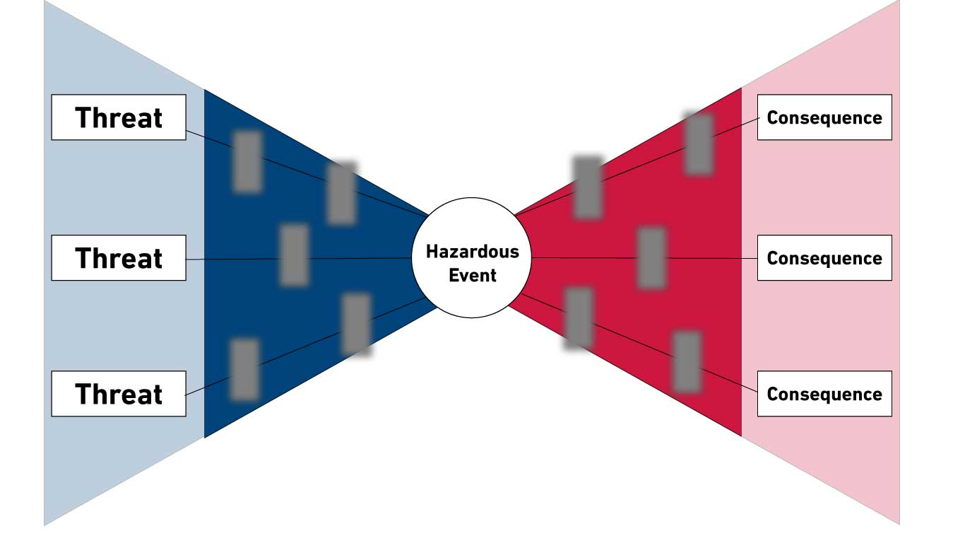
Preparation STEP 3: REVIEW OF MAJOR HAZARDS
Review major hazards associated with current activities
Review major hazard barriers
Review historical events related to associated major hazards
Notes:
JASON: A main focus of the engagement might be to evaluate whether the barriers that will prevent a major incident are meeting performance requirements. An operation may be exposed to several major hazards at any given time and it is important that Leaders periodically evaluate both prevention and mitigation barriers. Therefore, a Leader should review and discuss major hazards present at the site, with emphasis on those that will be active during the visit, emerging in near-future activities, and target those barriers for review and discussion. A review of routine daily hazard analyses might also be valuable.
The Leader should be aware and familiar of consequences that could occur if the prevention or mitigation barriers fail. Examples include:
• Loss of primary containment
• Loss of integrity
• Exceeding discharge limits
• Dropped Objects
• Helicopter Crash
• Marine collision
• Harm to people
• Harm to the environment
• Damage or loss of Asset

Slide 25






Preparation STEP 4: SET OBJECTIVES
Demonstrate safety
Evaluate
Evaluate safety culture and SEMS effectiveness
Communicate HSSE performances and learnings
Communicate new requirements
Recognition
safety culture
safety culture
Recognition
Recognition
performances and learnings
SEMS effectiveness
performances and learnings
conformance
SEMS effectiveness
conformance
requirements
requirements
commitment
commitment
| 25
Notes:
Jason: (* highlight the word on the slide)
Using the information collected in previous steps, the Leader should set Objectives for the visit. Items to consider in setting the objectives include:
• Demonstrating a visible and sincere commitment to Safety. (*commitment)
• Evaluation of conformance to Safe Work Practices, site requirements, barrier implementation, etc. (*conformance)
• Addressing a specific concern or issue generated by personnel at the site
Leadership commitment to Safe and Compliant operations and reinforcement of the SEMS program. (*Safety culture and SEMS effectiveness)
• Communication of new or progress in regards to HSSE Goals and Objectives along with learnings in accordance with the sites lesson learned program. (* performances and learnings)
• Communication of new requirements to be implemented. (*requirements)
• Positive recognition of an individual or a team for an achievement or a Stop Work Authority intervention . (*recognition)

Slide 26

Preparation STEP 5: PERSONAL PREPARATIONS
PPE
Training
Meet with SME for insights, suggestions, and requests.
Preparation is Key!
Notes:
JASON: Step 5 in the Preparation phase is Personal Preparations.
The Leader should be well equipped and prepared to travel offshore. The Leader should have all required personal protective equipment, ensure all training is up to date and avoid the need for any travel dispensations.
Depending on the objectives of the visit, the Leader may choose to meet with other functional leaders to gather insight into any areas of concern and/or areas that may need additional focus offshore or simply to review additional requirements or procedures while offshore.
If the engagement is going to involve speaking to a large audience, the Leader should be prepared to cover the objectives of the engagement. The OOL could share good practices and experiences to drive key messages. Use simple techniques to illustrate and reinforce performance, recognition, major hazards, barriers, etc.
Adequate preparation is fundamental to an effective Leadership site visit.

Slide 27
Preparation STEP 6: COMPLETE A LSE PLAN
OOL Develop Their Objectives for the LSE
OOL consider who they will engage with and why.
LSE should always include engagement with:
Site Leadership
Contractor Leadership
Site walk around engaging individuals
List activities to be observed, and barriers you want to make sure get discussed in the conversation
Consider how you will capture important learnings from conversations and observations
Discuss your LSE plan with the Senior Offshore Leader at the site
| 27
Notes:
Jason:
The Leader may formalize the visit by completing a LSE Plan. The Plan can then be used to structure the engagement, communicate its objectives and logistics, and to gain alignment from those who may be impacted. The Plan might include specific structural or logistical information.
Inputs to consider for the Plan include:
Develop relevant objectives for the visit.
Define offshore engagement opportunities: offshore leaders, employees, contractors. Aim to engage with personnel at all levels offshore. Try not to exclude anyone from the engagements.
List any specific activities, processes or barriers you would like to have discussions about.
Establish how you will document discussions and memorialize the offshore visit.
Review your plan with the senior most leader offshore to gain alignment.

Slide 28
LEADERSHIP SITE ENGAGEMENT EXECUTION
SITE
ORIENTATION
SITE LEADERSHIP MEETING
CONTRACTOR LEADERSHIP MEETING
WORKFORCE MEETING
SITE
WALK AROUND
Figure 5—LSE Execution Steps
Notes:
Jason: (Click to bring all the steps into the slide)
The second phase of Leadership Site Engagement is Execution.
The first principle is that a Leader visiting an offshore location will utilize Stop Work Autjhority, as appropriate, if a safety concern is discovered during a visit. No different than what the offshore workforce is also responsible and obligated to do.
The execution phase of the LSE involves the steps illustrated in Figure 5 of the document.
These include:
SITE ORIENTATION
SITE LEADERSHIP MEETING
CONTRACTOR LEADERSHIP MEETING
WORKFORCE MEETING
SITE WALK AROUND

Slide 29
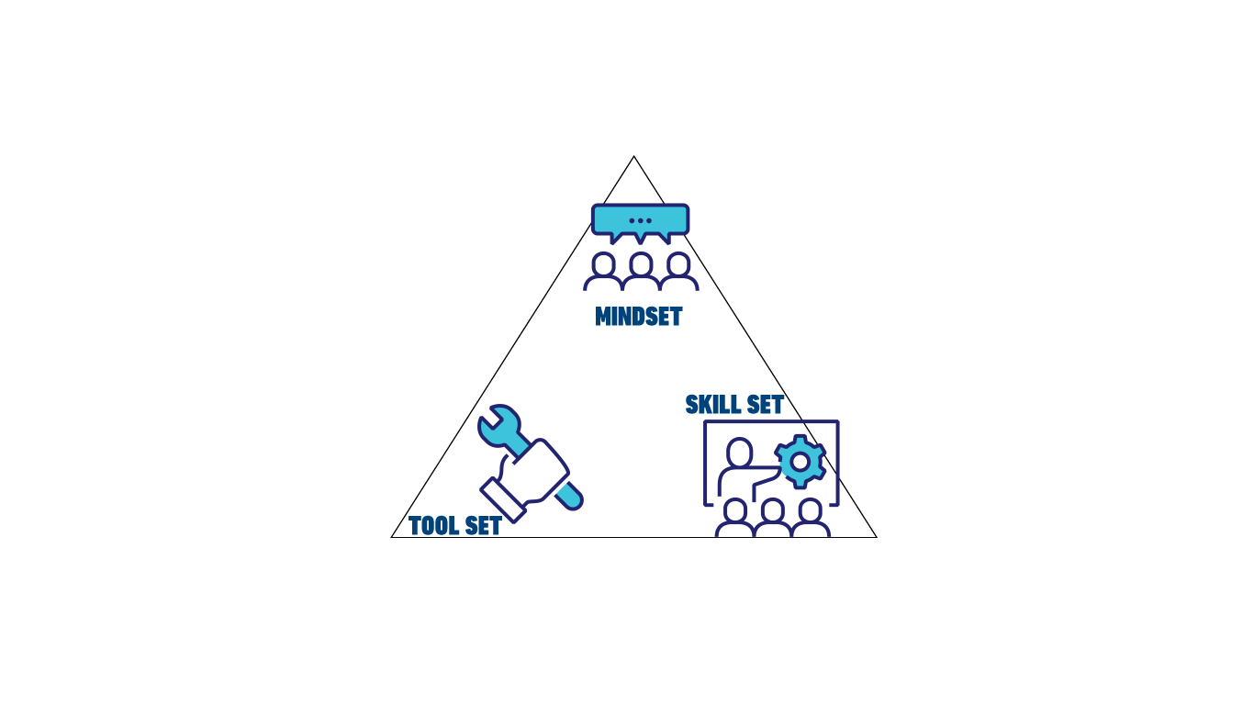
Execution SITE ORIENTATION
Critical to your safety and the safety of everyone at the site
Participate in full site induction (same as all offshore visitors)
Ensure understanding!
Notes:
Jason:
Upon arriving at the site, the Leader should go thru the exact same orientation or induction, as any other visitor would do.
The orientation will review relevant information specific to the asset. It is also an opportunity to hear the current operating conditions. The Leader should ensure they are familiar with and understand key emergency response actions and obligations. If unsure.....Ask!
During the orientation, the OOL should listen for and potentially evaluate and reinforce the following:
• SEMS
• Station bill – muster point location and an alternate, if available
• Emergency shutdown device stations
• Stop work authority
• Major hazards
• Local site rules and restrictions e.g. medication, drugs, alcohol, smoking, firearms
• Major activities currently underway and planned
• Alarms – purpose and types
• Environmental requirements
• Regulatory requirements
• Incident reporting requirements
• Safe work practices
• Organizational structure – accountabilities
The OOL should demonstrate safety leadership by listening, showing interest, asking questions for clarity, and understanding, and providing constructive feedback.

Slide 30

Execution LEADERSHIP SITE MEETINGS
Site Leadership Meeting
  Discuss the plan
  Discuss current operations
  Establish ground rules
Contractor Leadership Meeting
Workforce Meeting
Notes:
JASON:
A meeting should be held with the offshore leadership team. The main purpose of this meeting is check the status of current activities and confirm any operational risks that may exist. It is also an opportunity to discuss the scope and objectives of the Leadership Site Engagement.
The Leader can also use this meeting to set the context for the engagement and ask open-ended questions to evaluate changes in activities or new concerns that may impact the original Plan.
An optional meeting could be held with the Contractor Leadership depending on the objectives of the visit. The purpose of this meeting may be to check the status of current activities from the Contractor’s perspective, to share learnings, and to visibly demonstrate the commitment to Safe and Compliant operations.
The Leader should take this opportunity to lead by example and ‘walk the talk’, specifically in actively listening to the workforce. Ask open-ended questions to create a two-way conversation, listen for concerns, and provide constructive and informative feedback. The result of the meeting may be changes to the original objectives and schedule of the engagement based on what is happening and any concerns heard.

Slide 31


Execution SITE WALK AROUND
Engage with the workforce ….LISTEN
Discuss Policies, Practices, and Procedures
Discuss Hazards and Barriers/Safeguards to seek understanding
Discuss Challenges and Opportunities
Support from Management
Discuss Stop Work Authority
"Person doing the job, knows the job best"
31
Notes:
JASON:
The final step in executing the engagement is a site walk around, which should be done at every visit. The purpose of the walk around is to evaluate whether specific barriers targeted in the Plan meet performance requirements, observe the execution of the work and the behaviors of people, and evaluate the equipment and work conditions. The walk around involves engaging the people doing the work in the actual work environment. The engagement can evaluate that:
• Documented practices and procedures are used to conduct the work and manage the barriers
• Accountabilities are known and understood for managing and using the barriers
• People have the knowledge and skills to manage and use the barriers
• Site verification processes are working effectively to demonstrate systematic and reliable control of the barrier
• Trust and respect permeate the site organization where safety concerns are freely raised and addressed and clear, realistic and acceptable criteria are established for decision-making in discussing and resolving conflicting objectives.
In conducting the walk around, the Leader should lead by example and ‘walk the talk’, particularly in following all site safe work practices. It is important that the Leader consider conducting the walk around during the night shift as well as the day shift and observe shift handovers and job safety analyses. The Leader should be in observation and listening mode and approach workers only when safe to do so. The Leader should ask open-ended questions and actively listen to the responses, paying specific attention to concerns and issues raised by the workforce. The Leader can provide constructive and informative feedback, share personal experiences and lessons learned, and ask if there is anything that can be improved in the way work is done at the site. Any observations of unsafe behaviors or conditions during the engagement may be addressed through corrective
action agreements with the worker(s). Leaders should recognize, reinforce and encourage good performance by individuals and teams. Any concerns that point to potential systemic issues may be captured for discussion with the offshore leadership team, as appropriate.
The primary objective of the walk around is to engage with the workforce, listen to concerns/issues and test/validate barriers, as applicable. In my opinion, this is the most important and valuable activity during a LSE visit.

Slide 32
LEADERSHIP SITE ENGAGEMENT CLOSURE
Workforce and Contractor Meeting
Leadership Meeting
Complete Closure
Action Items, Significant Observations. Recommendations
| 32
Notes:
JASON:
The final step of the Leadership Site Engagement is Closure. Closure not only means ending the engagement at the site, but also evaluating if the objectives have been met, agreeing and assigning any actions that have been generated and, if appropriate, documenting the results. Some actions may have been agreed and concluded in real time to correct unsafe behaviors or conditions. Advance
WORKFORCE AND CONTRACTOR LEADERSHIP MEETINGS
If the optional engagement meeting with the workforce and/or Contractor Leadership occurred, the Leader may want to bring those groups back together and provide feedback on what was observed, focusing on the positive recognitions and the systemic concerns that were raised by the people engaged during the walk around. The Leader may want to commit to any actions that will be taken personally or ask for commitment from the workers or the Contractor Leadership.
Advance
SITE LEADERSHIP MEETING
The final meeting before departing the site should be with the offshore leadership team. The purpose of this meeting is to provide the results of the engagement and provide a perspective on the health of the implementation of the safety and environmental management system and the site safety culture. It is recommended that any significant interventions that occurred during the engagement be communicated. The Leader should inform the offshore leadership team of any systemic concerns that were raised during the engagement and any actions that were agreed. All actions generated by the engagement may be documented with accountability and due date.
Advance
COMPLETE CLOSURE
The LSE officially ends when the Closure Section of the Plan, if used, is completed and communicated to the appropriate persons. The Closure Section lists the outcomes versus the planned objectives that could include results, opportunities for improvement, recognitions, interventions, and actions. It is recommended that any actions generated by the engagement be tracked to closure by the OOL or designees. The final completed Plan may then be used in planning the next engagement at that site.

Slide 33
KEY CONSIDERATIONS – CLOSING MEETING
What you say and how you say it is important, what you don’t say may be just as important
Discuss results with Site Leadership – Successes and Opportunities
Actions and Opportunities for onshore based functions to improve and support
Agreement and assignment of any actions that have been generated
Documenting the results, if appropriate.
Notes:
Jason:
A meeting should be held with the offshore workforce, if at all possible. The intent is to thank them for engaging and raising concerns and opportunities. Stress the importance of being candid and raising issues so they can be addressed accordingly.
The meeting can be held in a townhall format to get the message to as much as the offshore workforce as possible. This is a great time to recognize them for achievements, improvements and opportunities to get better. Be candid, down to earth and sincere in your message, as this will resonate over time and demonstrate the commitment to a Safe and Compliant operation.
Thanks for your time this morning.......over to you Josh.

Slide 34
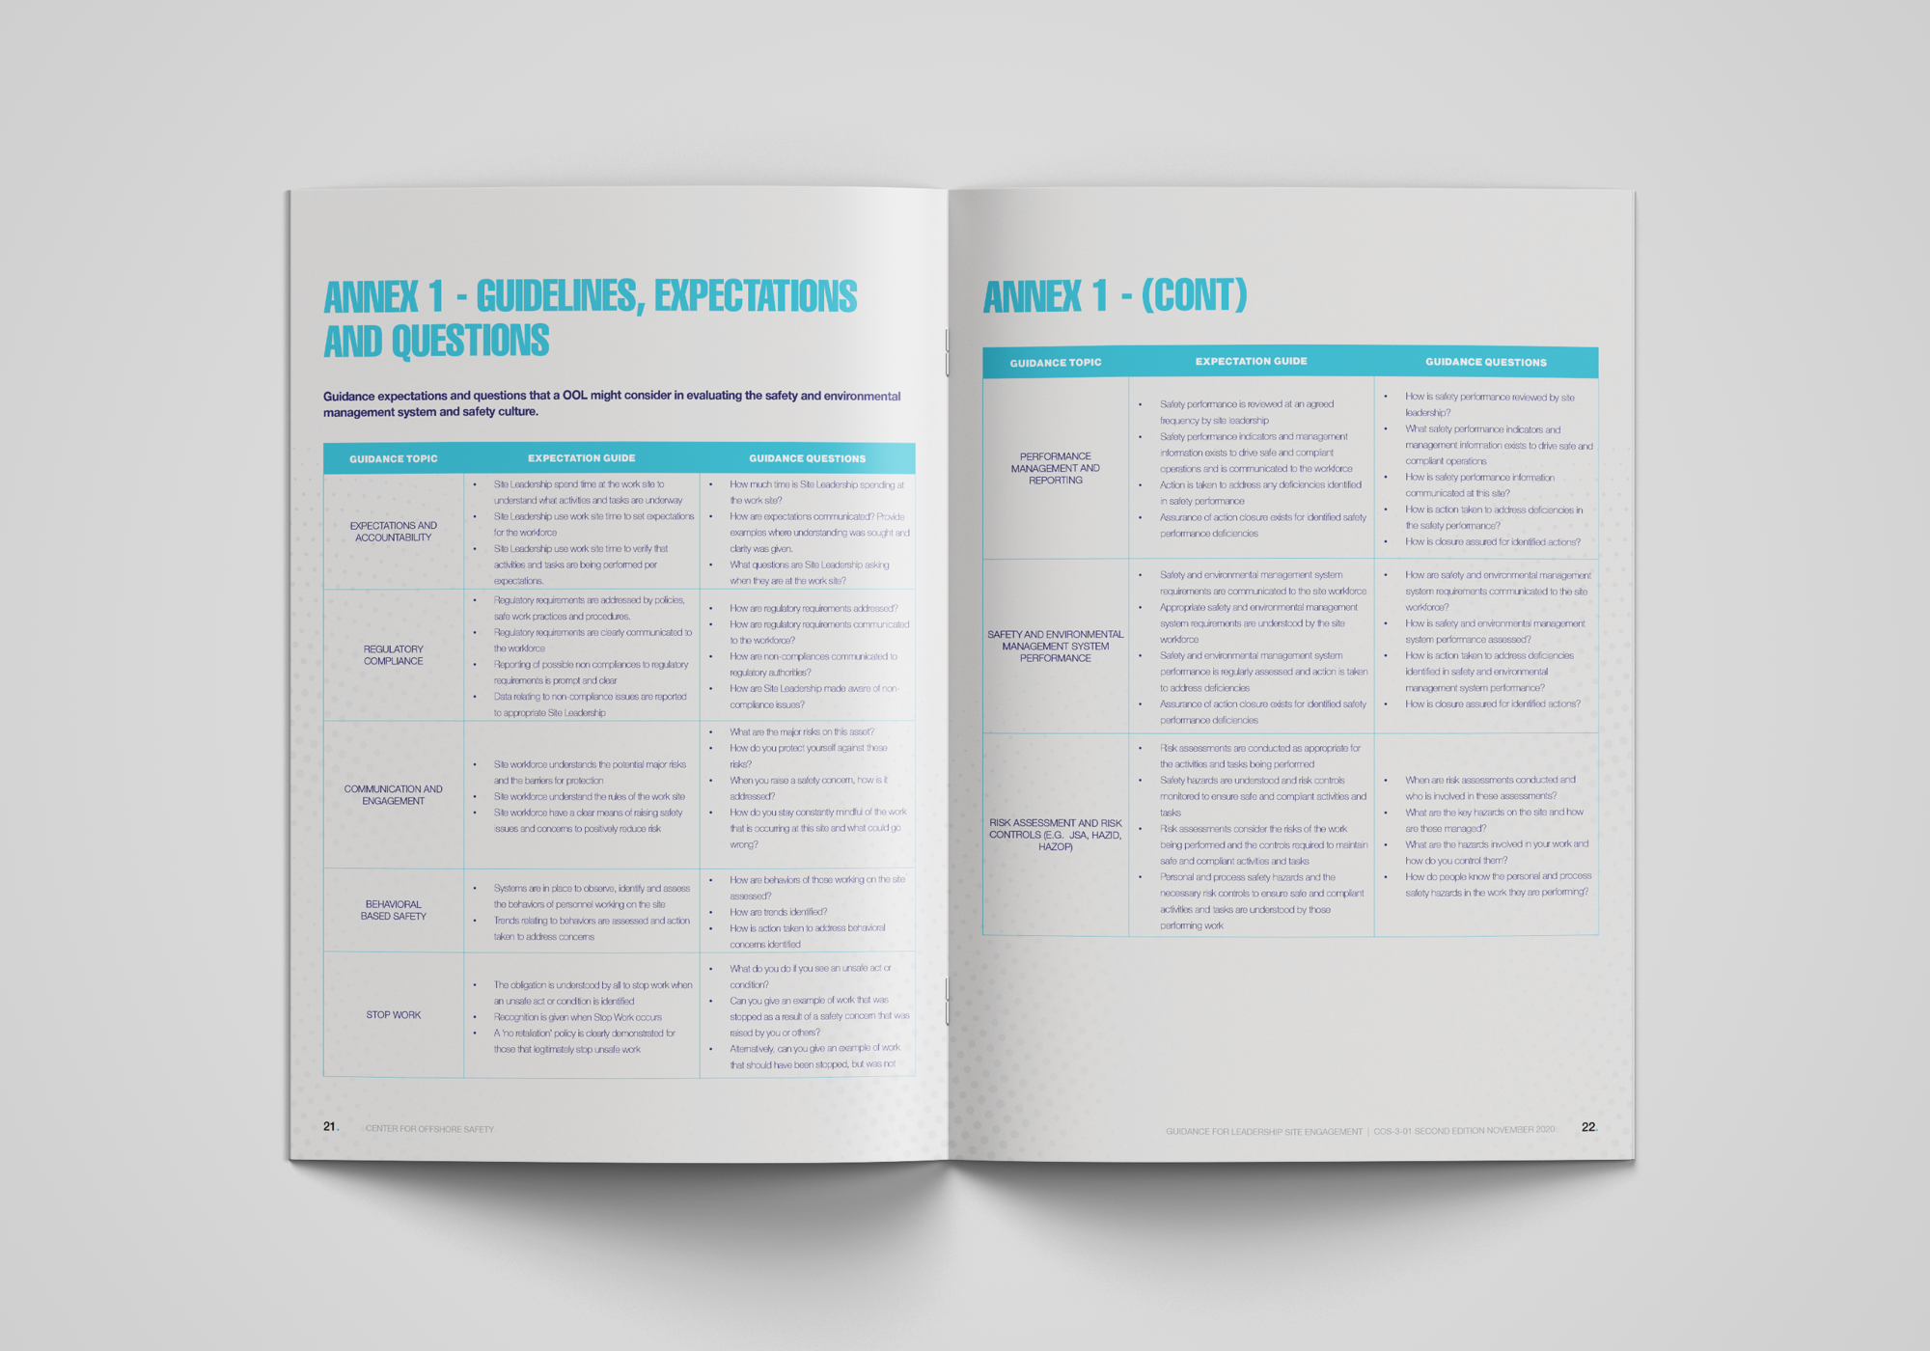

ANNEX 1 - GUIDANCE EXPECTATIONS
AND QUESTIONS
| 34
FIGURE 2 — Safety Culture Characteristics
Notes:
Josh: Good morning, my name is Josh Oldag with Oceaneering. I will be walking through some of the specific tools that can help you to organize your Leadership Site Engagement.
Annex 1 includes examples of guidance expectations and questions that an Office-Based Operations Leader, might consider, in evaluating the safety and environmental management system and safety culture.
Some of these topics may apply, while others may not, and although it’s not an all-inclusive list, it should give all companies, regardless of the maturity of your existing processes, a great reference to use.
Thirty-four of the original thirty-five topics from the first edition are included in the second edition. Operating Procedures was removed, but the expectations have been spread to other topics like Safe Work Practices and Procedures.
The other changes from the first version to the second version are minor terminology changes.

Slide 35

ANNEX 2 - EXAMPLE OF A LEADERSHIP
SITE ENGAGEMENT PLAN
| 35
FIGURE 2 — Safety Culture Characteristics
Notes:
Josh: Because preparation and quick closure of identified issues is critical to ensuring that the Leadership Site Engagement is efficient and provides value to your organization, we've included two examples of Leadership Site Engagement Plans.
The first, in Annex 2, is a blank form with general items for consideration. It includes things like objectives that will be covered, actions you would like to observe, people who will need to be engaged, and meetings you would like to hold. The closure section of the plan is an excellent reminder that these visits are an opportunity to develop actions to address identified improvements and recognize individuals or teams. The key aspect of action plans is that actions are clear to the assigned responsible person and that the leader communicates their expectations and due dates.
There were no changes to Annex 2 in the second version when compared to the first version of the document.

Slide 36

ANNEX 3 - LEADERSHIP SITE ENGAGEMENT
EXAMPLE PREPARATION
FIGURE 2 — Safety Culture Characteristics
| 36
Notes:
Josh: Building on the template in Annex 2, Annex 3 is a practical example of what the planning, execution and closure of a Leadership Site Engagement might look like.
There were no changes to Annex 3 in the second version when compared to the first version of the document.

Slide 37
Special Thanks to the
COS Leadership Site Engagement Work Group
Notes:
Josh: Thank you to the members of the COS Leadership Site Engagement Revision Work Group for their hard work in preparing for this webinar. And also, thank you, to the presenters today, who all have openly shared their knowledge and many years of experience working in and supporting the offshore oil and natural gas industry.

Slide 38

Notes:
Josh: If you have not yet done so, we invite you to visit the newly designed COS website to download the document. The COS-3-01 can be found by going to the Guidelines and Reports page and then SEMS Good Practices. If you have any trouble locating the document, please get in touch with COS staff.

Slide 39

Questions & Answers
Notes:
Josh: We will now address some of the submitted questions pertaining to the document. If you haven’t already, please type your questions in the chat box or use the Teams feature and raise your hand if you'd like to verbally ask a question.
Miriam:
Lets take a look at our Chat box to see if we have any questions......

Slide 40
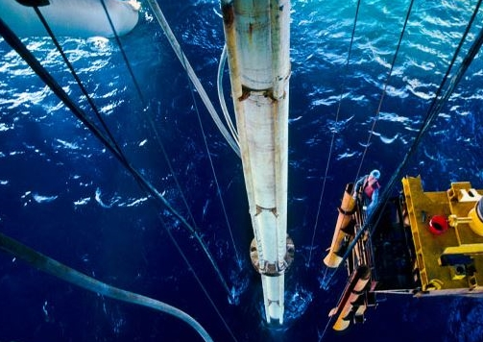

Join Us!
COS Annual Forum
October 27, 2021
Registration Information:
www.centerforoffshoresafety.org
Spotlights on Excellence – finalists for the 2021 COS Safety Leadership Award
Conversations with BSEE and USCG
Notes:
Russ: Thank you for joining us today for this webinar, which is a part of a COS Webinar Series for the year. We want to remind you to visit our website and register for this year's COS Safety Forum to take place virtually in on October 27th.

